Slide 1



UNIT 3: School
Timetable

Slide 2
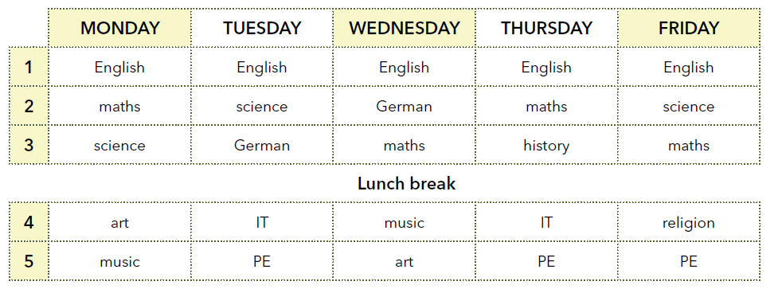
How many lessons has Noah got each day?
How many languages does he study?
Is it the same for you?
Which subjects has he got on Monday / Tuesday / Wednesday/ etc.*?
When is his lunch break?
What about you?
Does he go to schol on Saturdays?

Slide 3
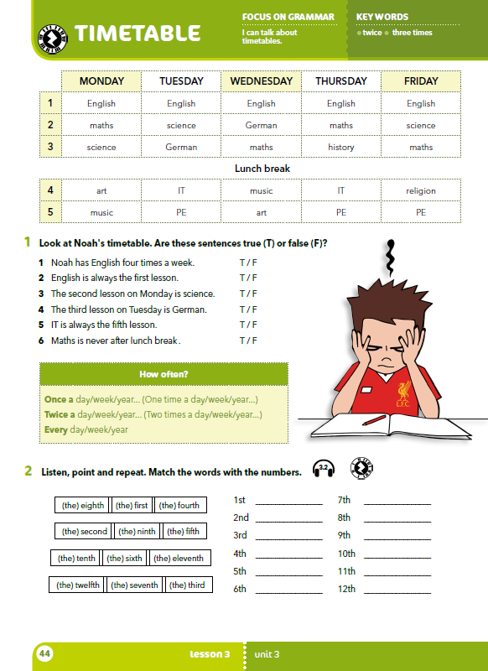
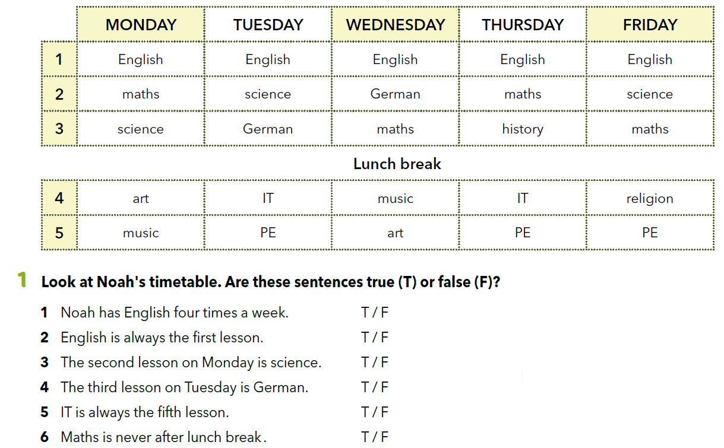
Look at Noah’s timetable. Are the sentences true (T) or false (F)?

Slide 4
How many times a week has Noah got religion?
One time a week.
One time a week.
= Once a week.
= Jednom tjedno.
One time a day / Once a day =
One time a month / Once a month =
One time a year / Once a year =
Jednom dnevno
Jednom mjesečno
Jednom godišnje

Slide 5
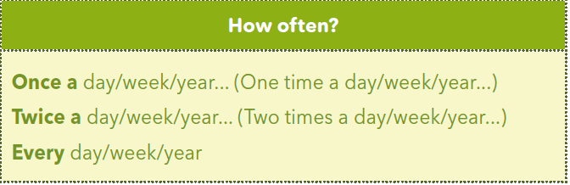
How often has Noah got IT?
Koliko često Noah ima informatiku?
Two times a week. ili Twice a week.
Dvaput tjedno.
Svaki tjedan =
Svake godine =
Every week.
How often has Noah got English?
Koliko često Noah ima engleski jezik?
Every day.
Svaki dan.
Every year.

Slide 6
Copy the following sentences in your notebook and complete them so they are true for you.
Once a week I _________________________.
Twice a week I _________________________.
Four times a week I ________________________.
Every day I ________________________.

Slide 7

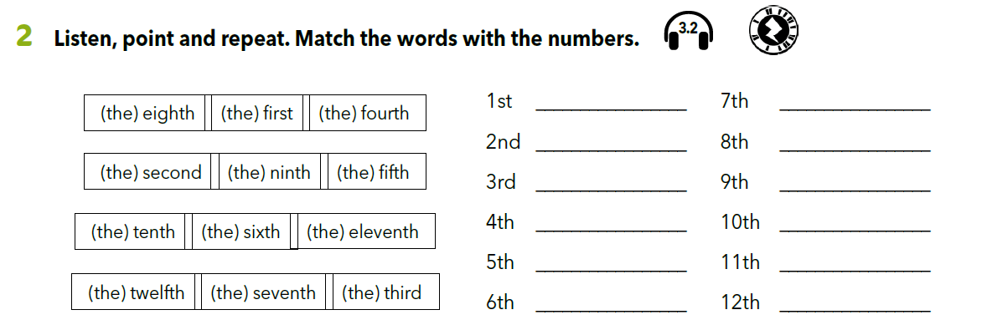
https://www.e-sfera.hr/dodatni-digitalni-sadrzaji/ededaac0-c4a6-4fd8-b07c-f42ff5ae5d4c/assets/audio/3_2.mp3
Listen, point and repeat.

Slide 8
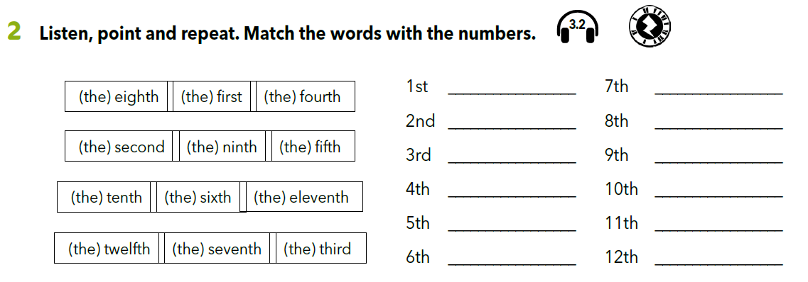
Copy the words on the lines.
(the) first
(the) seventh
(the) second
(the) eighth
(the) third
(the) ninth
(the) fourth
(the) tenth
(the) fifth
(the) eleventh
(the) sixth
(the) twelfth

Slide 9
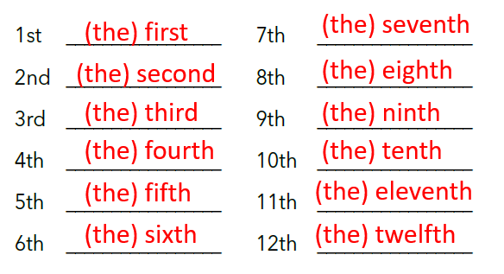
What do we write next to the number?
These are ordinal numbers.
We add the suffix ”th”:
(the) fourth → 4th
(the) tenth → 10th
Numbers 1, 2 and 3 have irregular form.
(the) first → 1st
(the) second → 2nd
(the) third → 3rd
Zapamti: u engleskom jeziku nikad ne pišemo redni broj s točkom (kao u hrvatskom jeziku) već dodajemo nastavak nakon broja kako bismo naznačili da govorimo o rednom broju!
1. December → 1st December 

Slide 10
Add the correct suffix and say the ordinal number.
13 23
14 24
15 25
16 26
17 27
18 28
19 29
20 30
21 31
22
(the) twenty - third
th (the) thirteenth
3rd
th
(the) fourteenth
4th
(the) twenty - fourth
th
(the) fifteenth
th
(the) twenty - fifth
th
(the) sixteenth
th
(the) twenty – sixth
th
(the) seventeenth
th
(the) twenty – seventh
th
(the) eighteenth
th
(the) twenty – eighth
th
(the) nineteenth
th
(the) twenty – ninth
th
(the) twentieth
th
(the) thirtieth
1st
(the) twenty - first
1 st
(the) thirty - first
2nd
(the) twenty - second

Slide 11
Kod rednih brojeva 21-29, 31-39, itd. nastavak dodajemo prema jedinici
21 --> 21st (twenty-first)
24 → 24th (twenty-fourth)
At what place are you in the class register?

Slide 12
Look at Noah’s timetable.
Try to memorize his timetable. You have 1 minute.

Slide 13
Answer these questions:
What is the third lesson on Wednesday?
What is the fifth lesson on Friday?
What is the first lesson on Monday?
What is the second lesson on Thursday?
What is the fourth lesson on Tuesday?

Slide 14
Let’s revise.
Ordinal numbers
Play the memory game.
https://www.bookwidgets.com/play/t:MI+k6QKqGcr0TsHD529lAWRH47wUWRuC0bm0Y8SEakZZRUtaWVI=

Slide 15
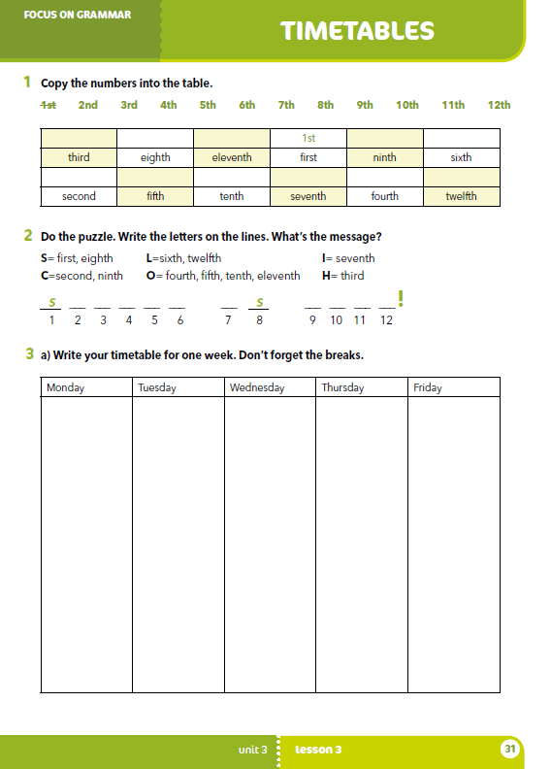
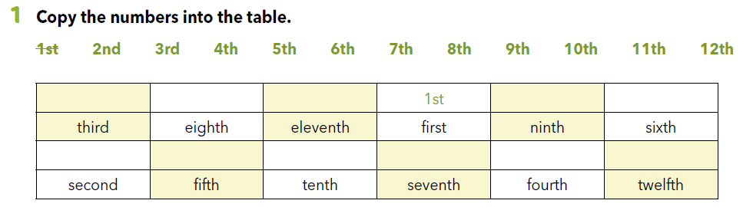
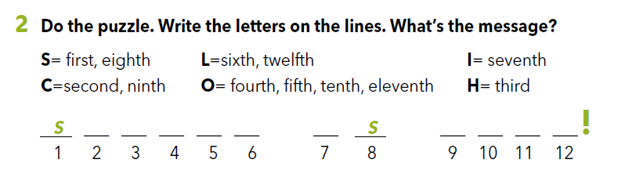
Workbook p 31.
3rd
8th
11th
9th
6th
2nd
5th
10th
7th
4th
12th
C H O O L I C O O L

Slide 16
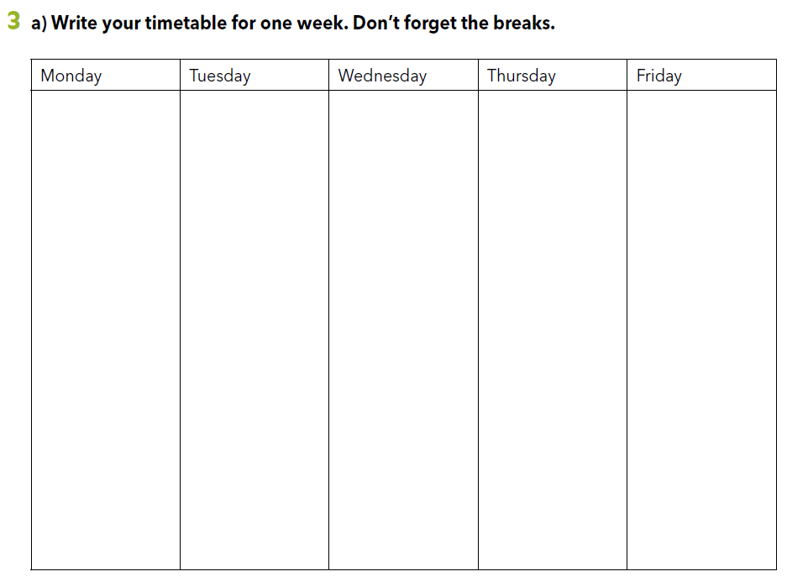
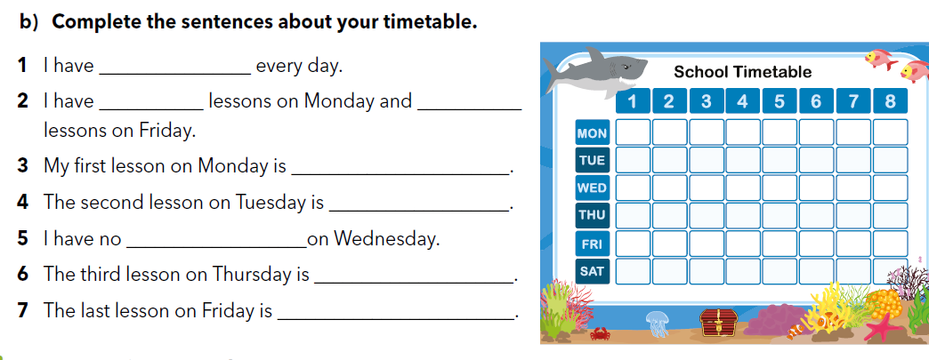
Napiši svoj raspored sati. Nemoj zaboraviti na male i veliki odmor.

Slide 17
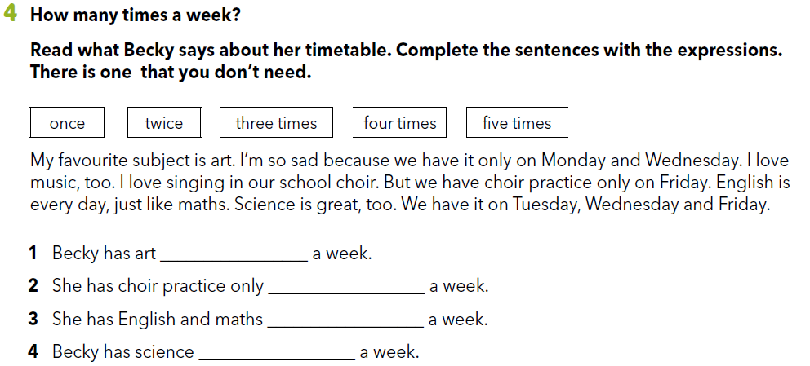
twice
once
five times
three times

Slide 18
